Slide 1

BIOIN 401: Giant Viruses
April 13, 2021
By: Tyler Watson

Slide 2
Project Timeline
Week
Week
…
4
5
6
7
1
2
3
4
5
6
Planning & Installation
viralRecall
Hybrid Gene Analysis & Circlize
12
11
10
9
8
Phylogenetic Trees
viralRecall

Slide 3

Week 1
1
Jan 14
Chose a paper→ Giant viruses
Formed a team→ Mustafa & Natalia
Began downloading & testing software
Looked into other optimal taxa

Slide 4
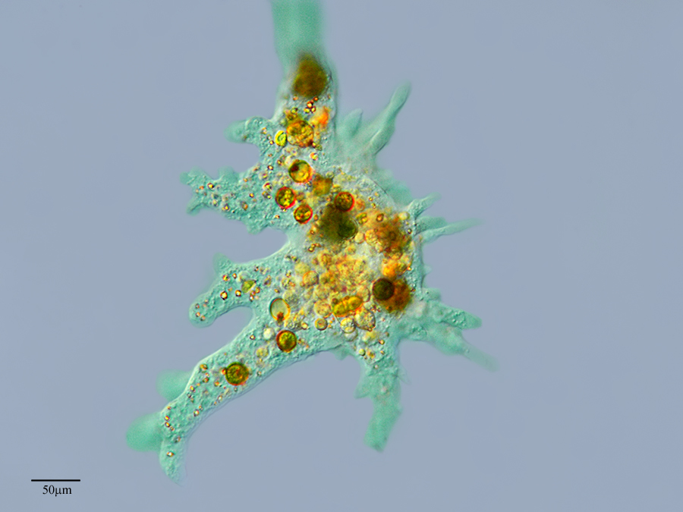
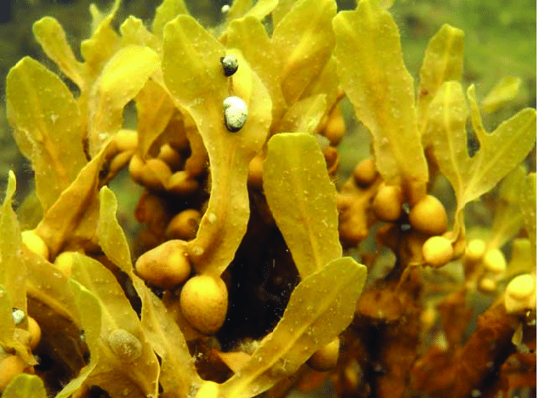
Extra Task - Evaluating Additional Taxa For Examination
Early on, we planned to investigate additional taxa for evidence of Giant Endogenized Viral Elements
Amoebozoa
Brown Algae
https://www.researchgate.net/figure/a-The-brown-algae-Fucus-vesiculosus-is-the-dominating-brown-algae-on-rocky-substrate-in_fig7_303488214
https://eol.org/pages/2915041

Slide 5
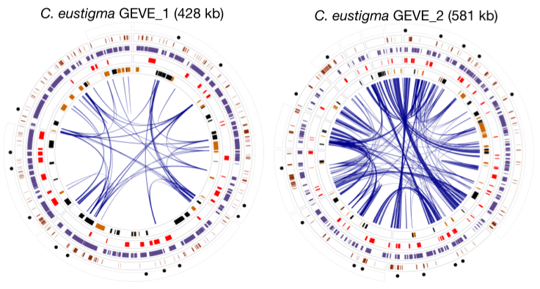
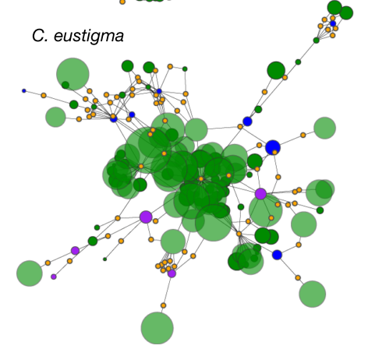
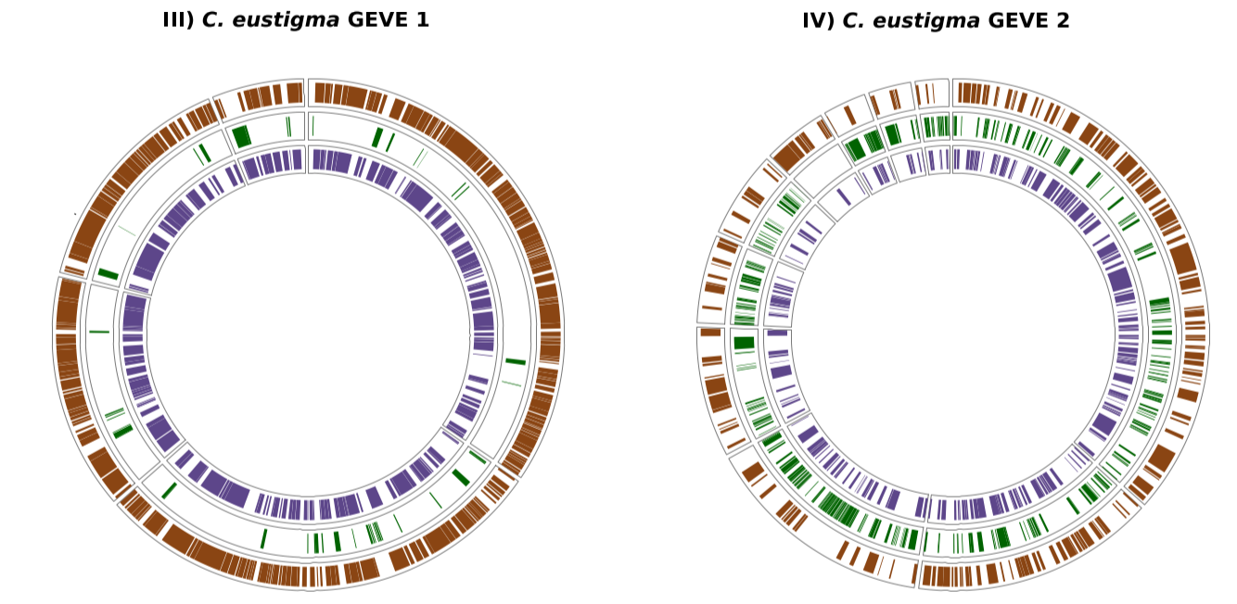
Week 2
1
2
Jan 14
Jan 19
Completed software installation and testing
Identified a single key species to test
Chlamydomonas eustigma
Figure 1.b
Figure 2.b
Extended Figure 4
Figure 1.b

Slide 6
Week 3
1
2
3
Jan 19
Jan 26
Ran C. eustigma genome through viralRecall
Function→ identifies evidence of giant viruses
Extensions
Prodigal→ Predicts protein-coding genes from prokaryotic genomes.
HMMER3→ Compares prodigal’s predicted ORFs to the Pfam and VoG databases
Pfam→ db of HMMs within cellular organisms but not viruses
VOG→ db of HMMs within viruses but not cellular organisms

Slide 7
Week 4
1
2
3
4
Jan 26
Feb 2
Began working on the hybrid gene analysis
AUGUSTUS→ good at predicting exon–intron boundaries
can under-predict viral genes
Prodigal→ effectively predicts virus genes
Does not predict exon–intron boundaries

Slide 8
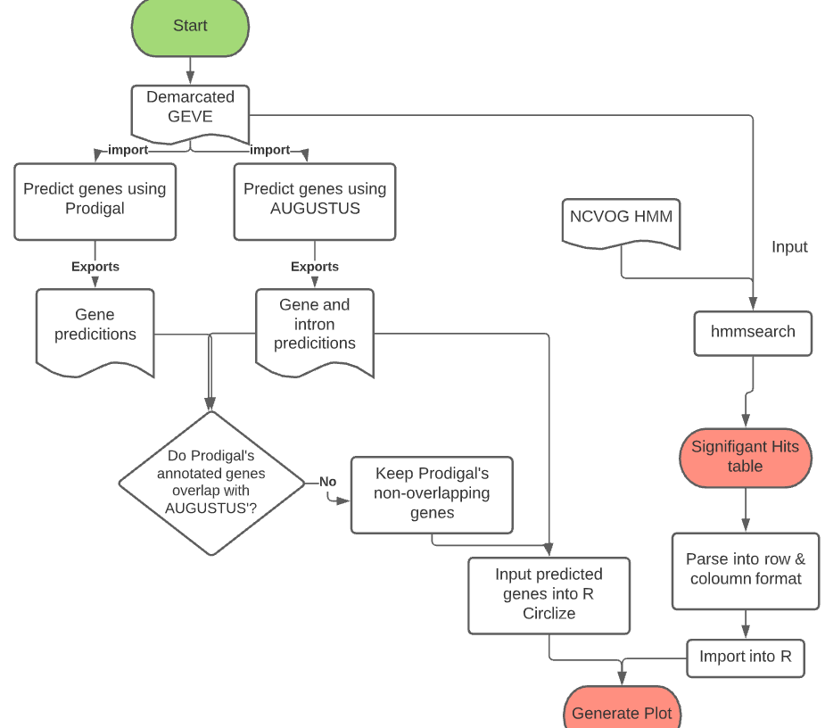
Hybrid gene analysis

Slide 9
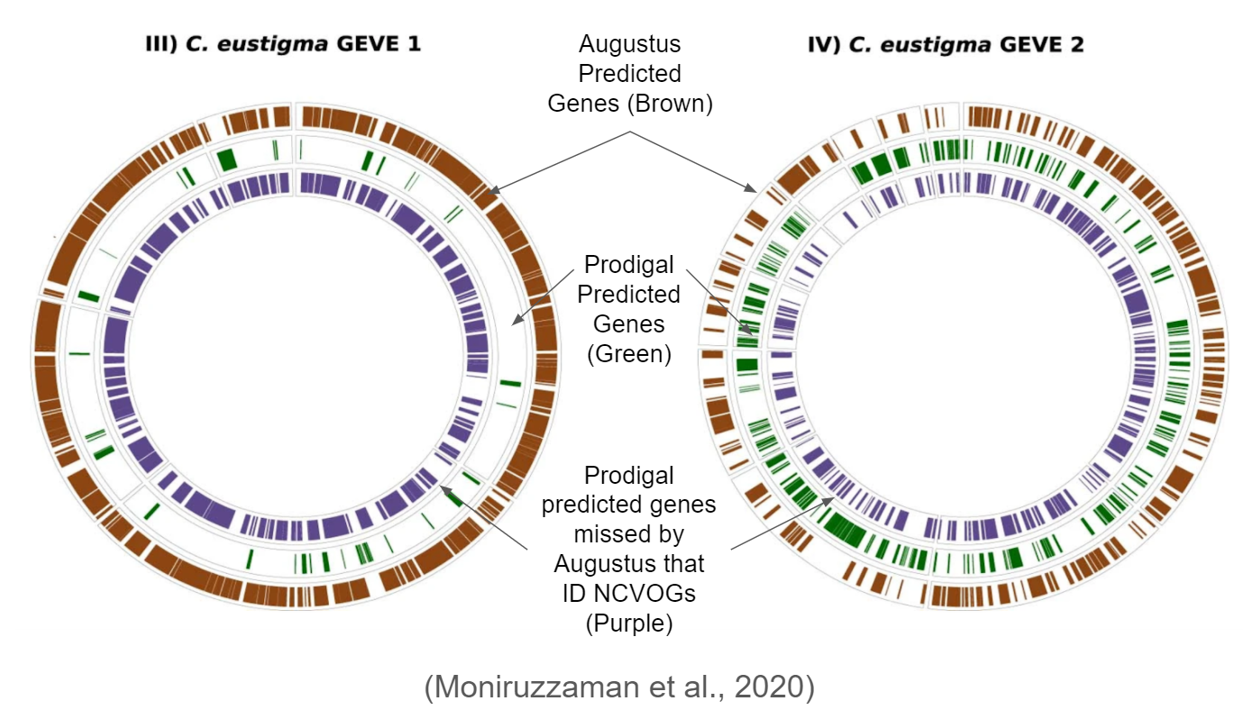
Week 4
Ext Figure 4.
1
2
3
4
Jan 26
Feb 2
Started using R Circlize
- Verification check for AUGUSTUS, Prodigal, and HMM Search

Slide 10
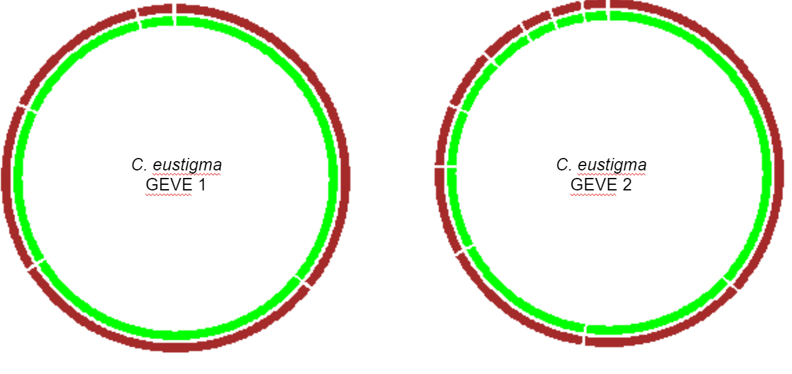
Week 4
1
2
3
4
Jan 26
Feb 2
Started using R Circlize
- Verification check for AUGUSTUS, Prodigal, and HMM Search
1ST attempt at replication….

Slide 11
Week 4
4
1
2
3
Jan 26
Feb 2
Began finding discrepancies in the paper
Incorrect data labeling
Differing NCBI chlorophyte species counts
65 species (2018) vs 122 species (current)
Vague methods statements
What exactly does “manual curation” entail?
Contacted the authors for clarification

Slide 12
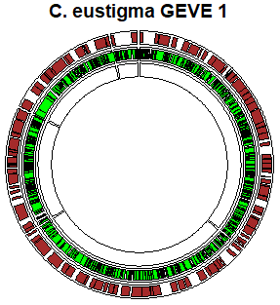
Week 5
Week
Week
4
5
2
3
Feb 2
Feb 9

Slide 13
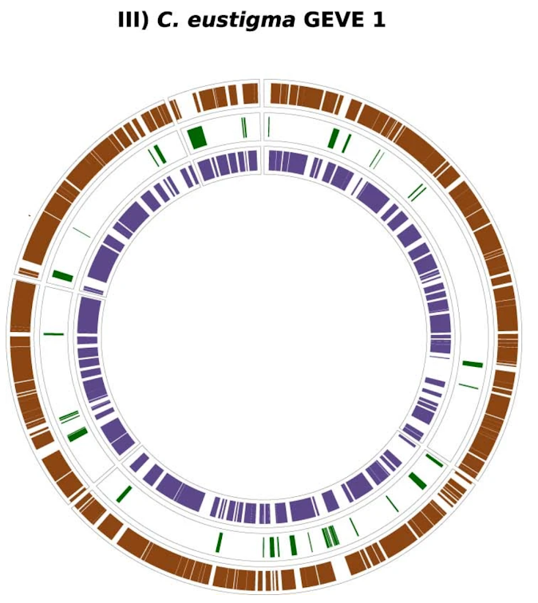
Week 5
2
3
4
5
Feb 9
Mine
VS
Author’s

Slide 14
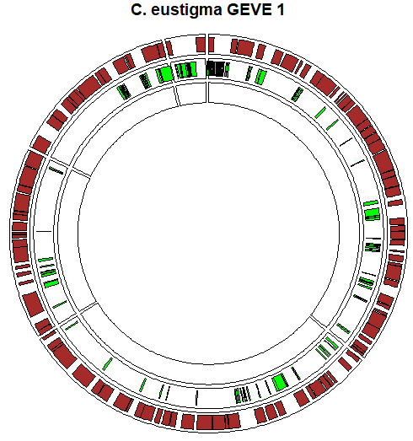
Week 6
Week
Week
5
6
3
4
Feb 9
Feb 23

Slide 15
Week 6
3
4
5
6
Feb 23
Mine
VS
Author’s

Slide 16
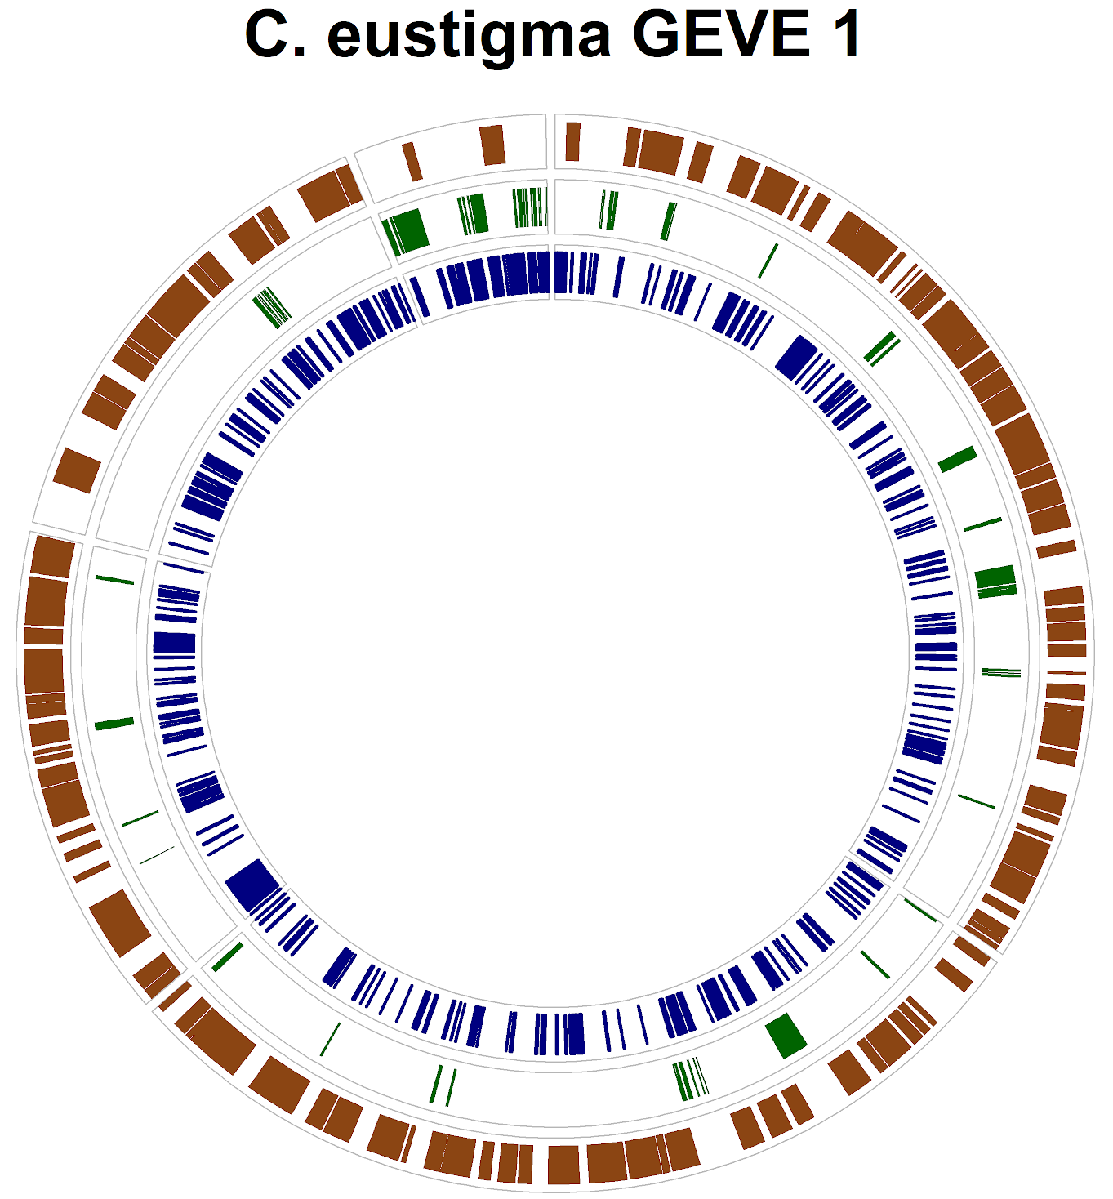
Week 7
Week
Week
6
7
4
5
Feb 23
March 2

Slide 17
Week 7
3
4
5
7
March 2
Mine
VS
Author’s

Slide 18
Week 8
8
5
6
7
March 9
Re-contacted Dr. Moniruzzaman for sample data
Augustus, Prodigal, and NCVOG hits for C. eustigma and T. socialis
Tested Prodigal→ Working perfectly!

Slide 19
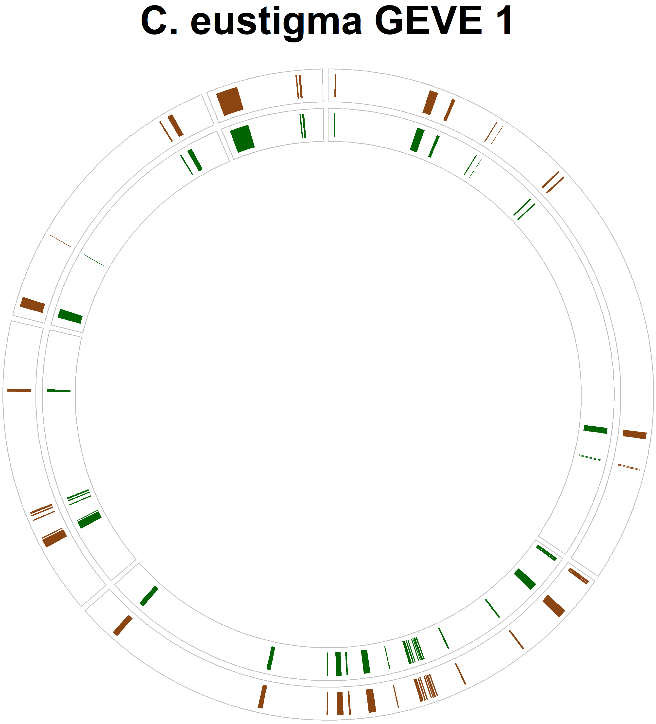
Results of Prodigal’s Gene Prediction
Ring 1: Author’s Data
Ring 2: My data

Slide 20
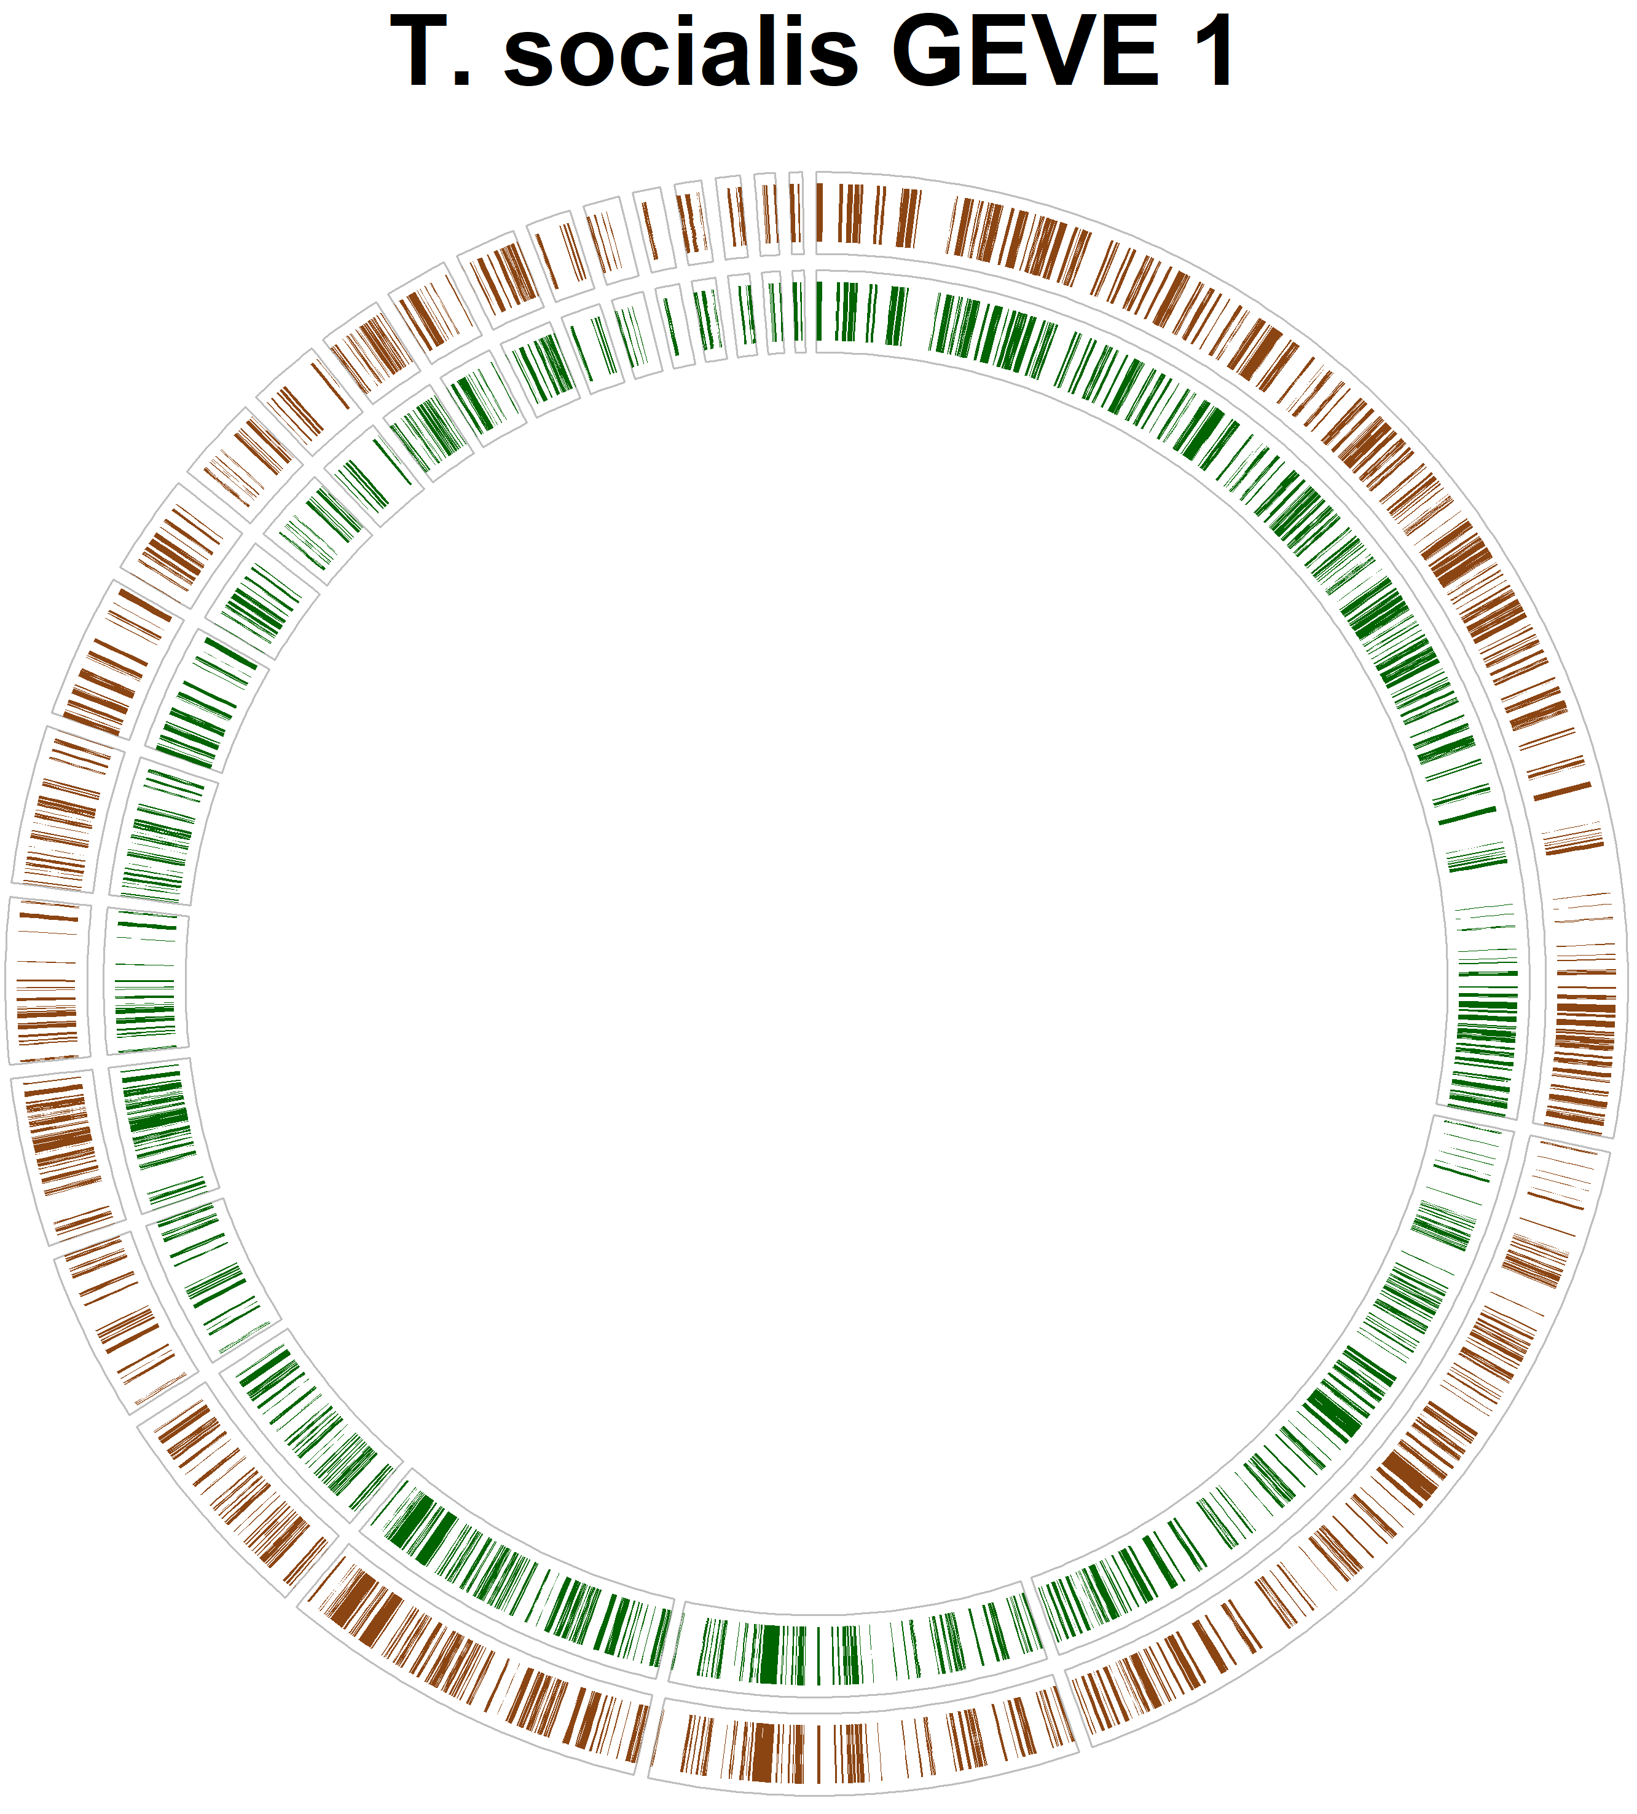
Results of Prodigal’s Gene Prediction
Ring 1: Author’s Data
Ring 2: My data

Slide 21
Week 8
8
5
6
7
March 9
Re-contacted Dr. Moniruzzaman for sample data
Augustus, Prodigal, and NCVOG hits for C. eustigma and T. socialis
Tested Prodigal→ Working perfectly!
Tested Augustus→ not working perfectly…

Slide 22
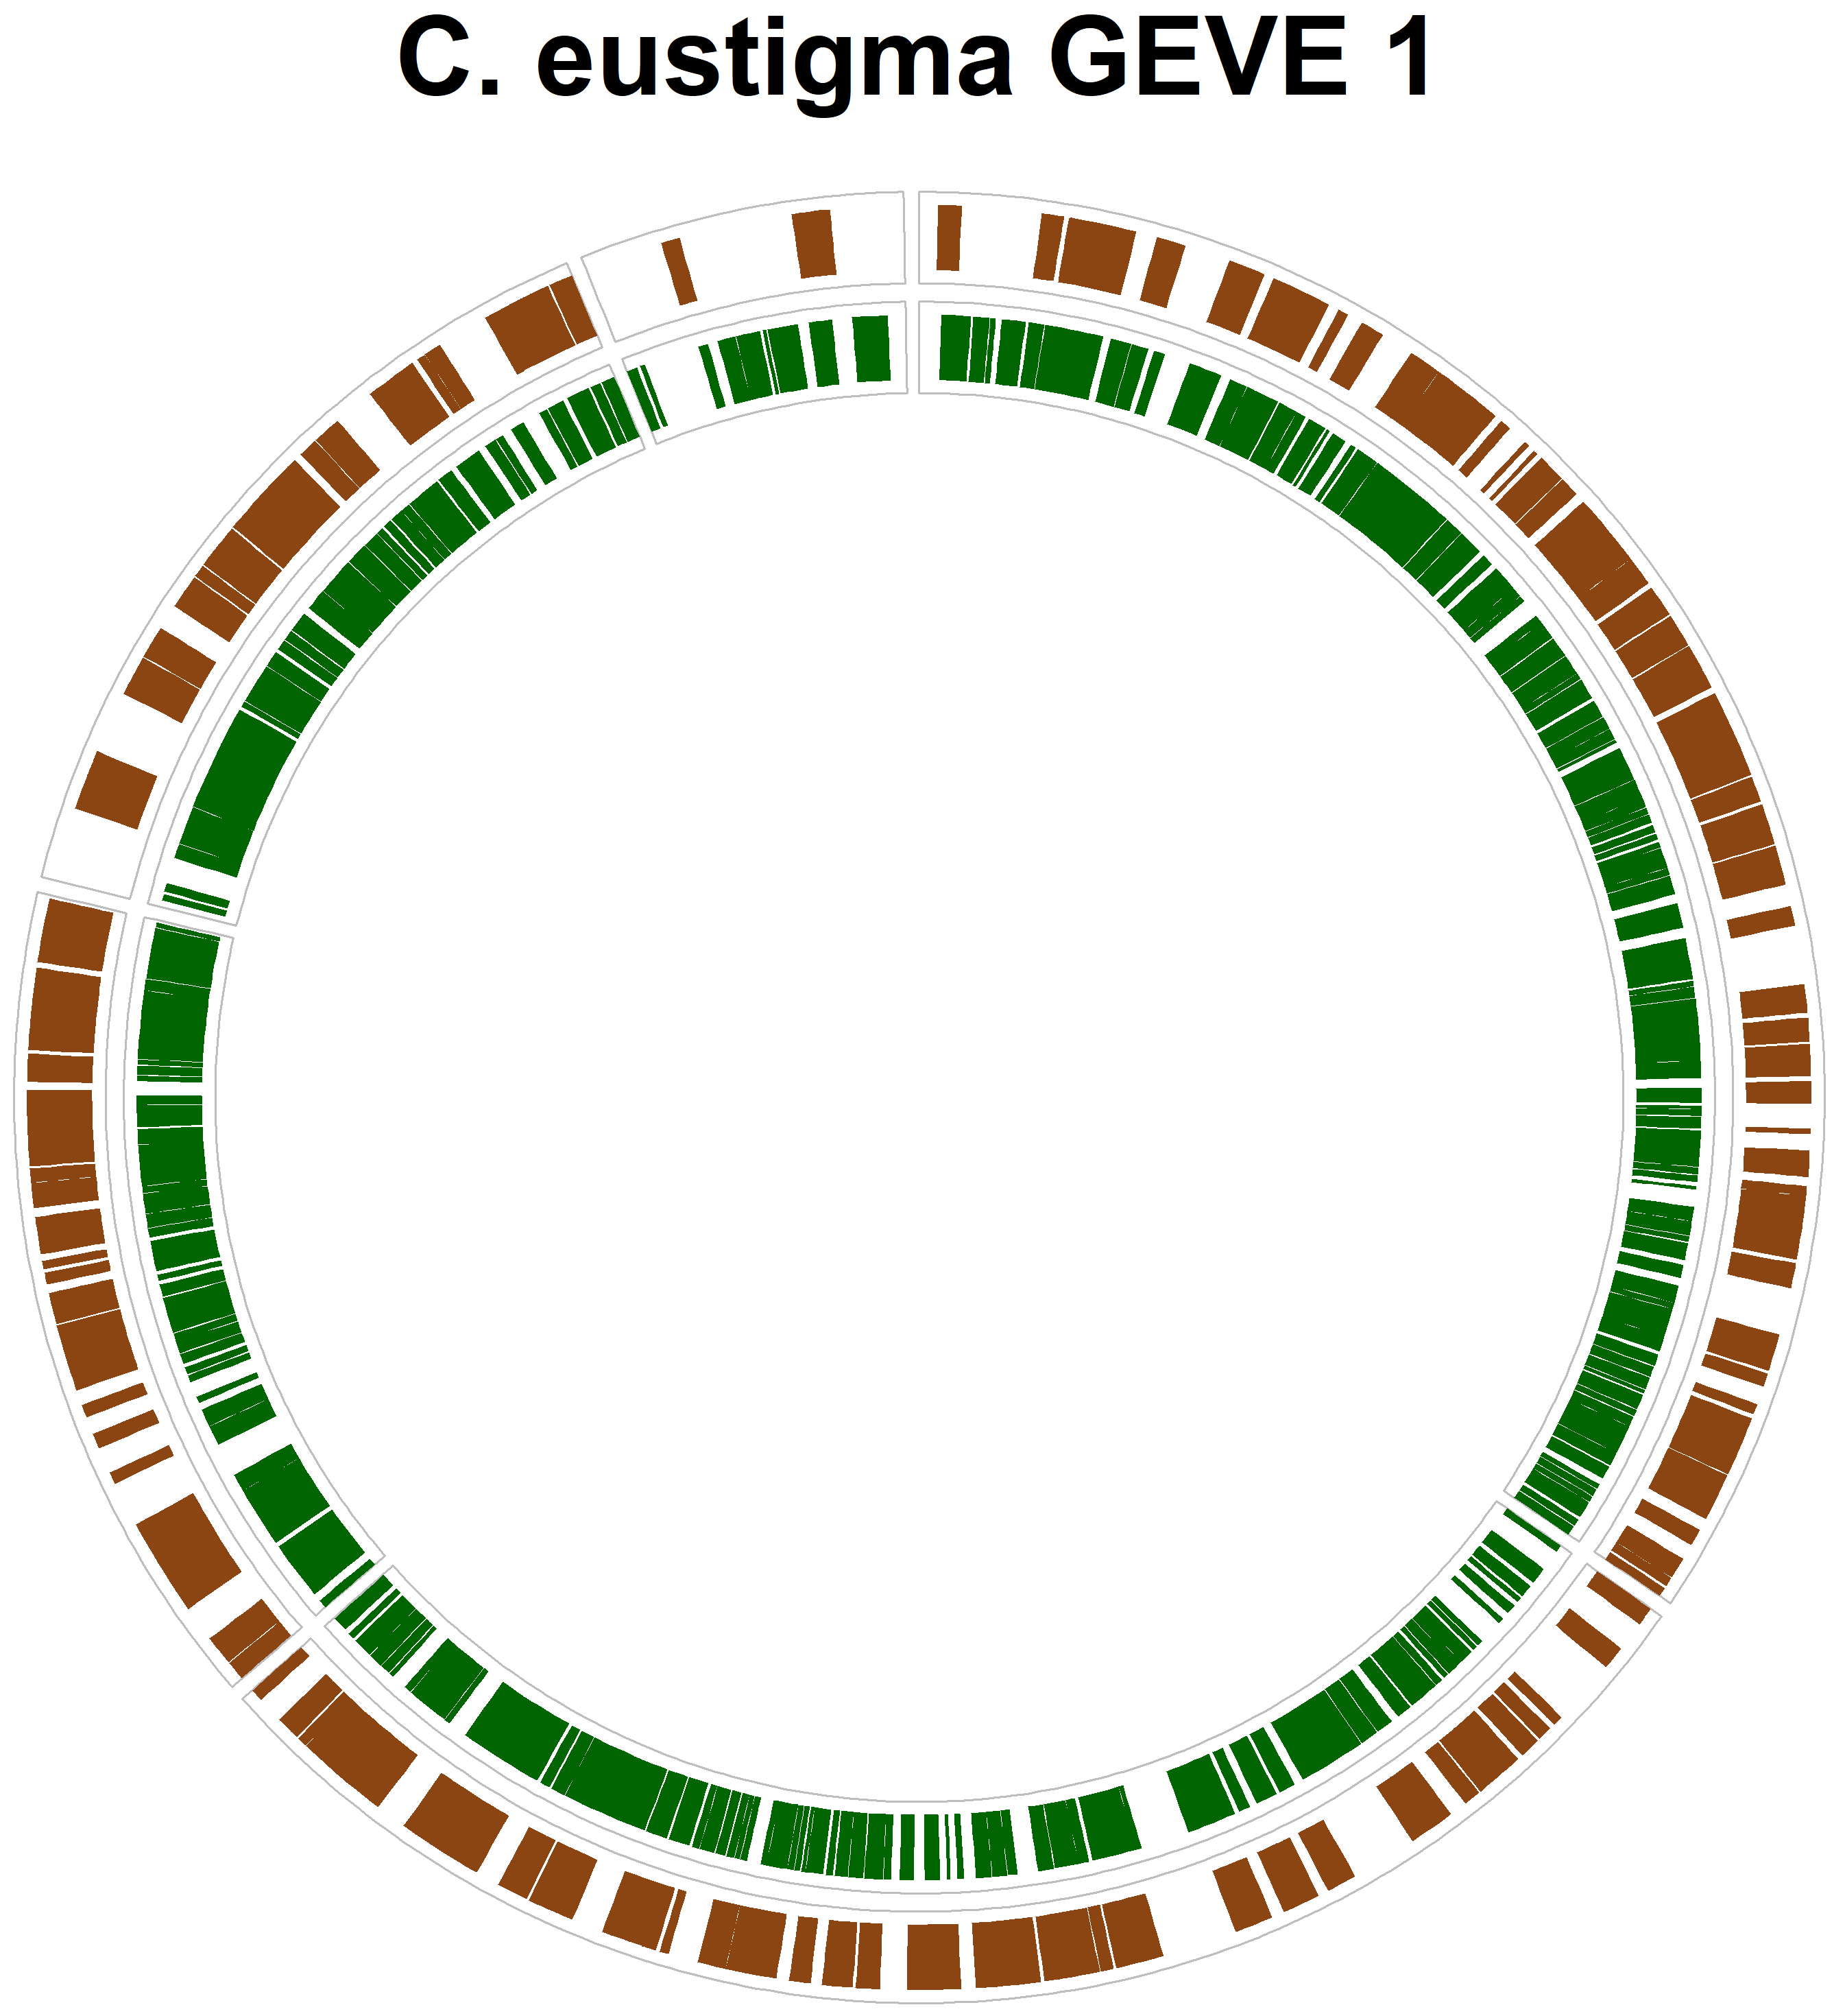
Results of Augustus’ Gene Prediction
Ring 1: My Data
Ring 2: Author’s data

Slide 23
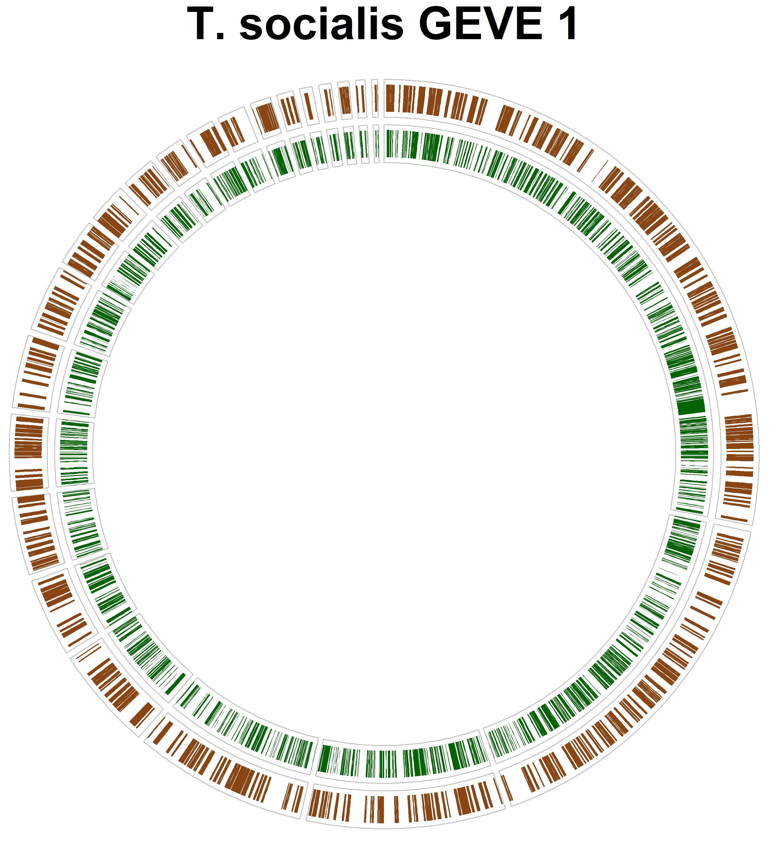
Results of Augustus’ Gene Prediction
Ring 1: My Data
Ring 2: Author’s data

Slide 24
Week 8
8
5
6
7
March 9
Re-contacted Dr. Moniruzzaman for sample data
Augustus, Prodigal, and NCVOG hits for C. eustigma and T. socialis
Tested Prodigal→ Working perfectly!
Tested Augustus→ not working perfectly…
Went back to viralRecall→ results did not correlate with the authors

Slide 25
Viral Recall Results
Test Genome: C. eustigma
 | Authors | Mine
Window Size | 15 ORFs | 15 ORFs
Length | >10 kb | >10 kb
VOG Hits | >4 | >4
Mean Score | >10 | >10
Viral Regions | 15 | 0

Slide 26
Week 9
9
6
7
8
March 16
Testing viralRecall’s parameters

Slide 27
Viral Recall Results
Test Genome: C. eustigma
 | Authors | Mine
Window Size | 15 ORFs | 10 ORFs
Length | >10 kb | >10 kb
VOG Hits | >4 | >3
Mean Score | >10 | >1
Viral Regions | 15 | 15
←Decreased to catch smaller viral regions
← 10 was previously used in an older versions, now 1 is the default
← Only 7 were correct

Slide 28
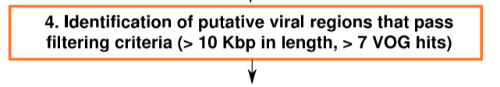
“Cut-offs were employed to remove low-confidence viral regions, including those that were very short (<10 kb), contained few viral genes (number of VOG hits of <4)” (Moniruzzaman et al., 2020)

Slide 29
“Cut-offs were employed to remove low-confidence viral regions, including those that were very short (<10 kb), contained few viral genes (number of VOG hits of <4)” (Moniruzzaman et al., 2020)
Good
??

Slide 30
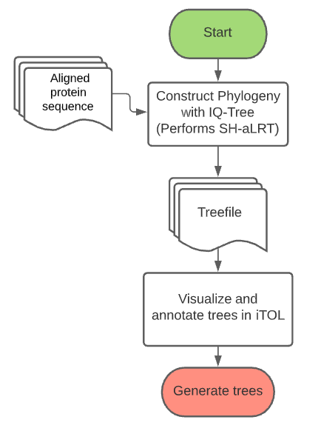
Week 10
10
7
8
9
March 23
Began generating the phylogenetic trees for figure 3
Purpose: Show the evolutionary history of GEVEs found in Chlorophyte genomes

Slide 31
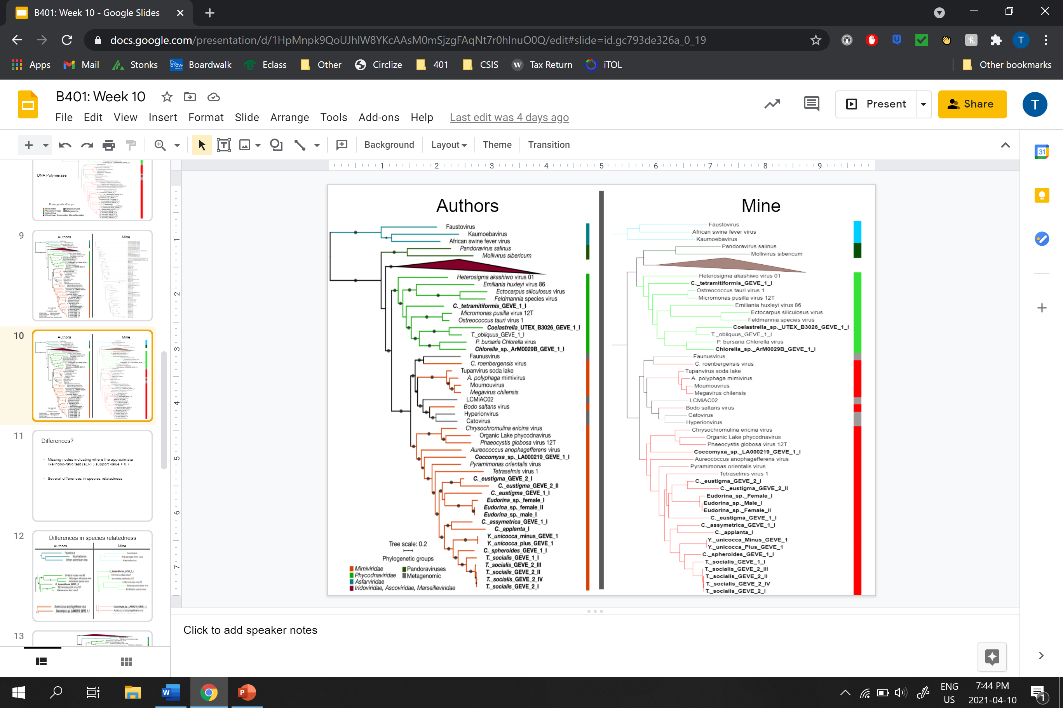
DNA Polymerase

Slide 32
DNA Polymerase

Slide 33
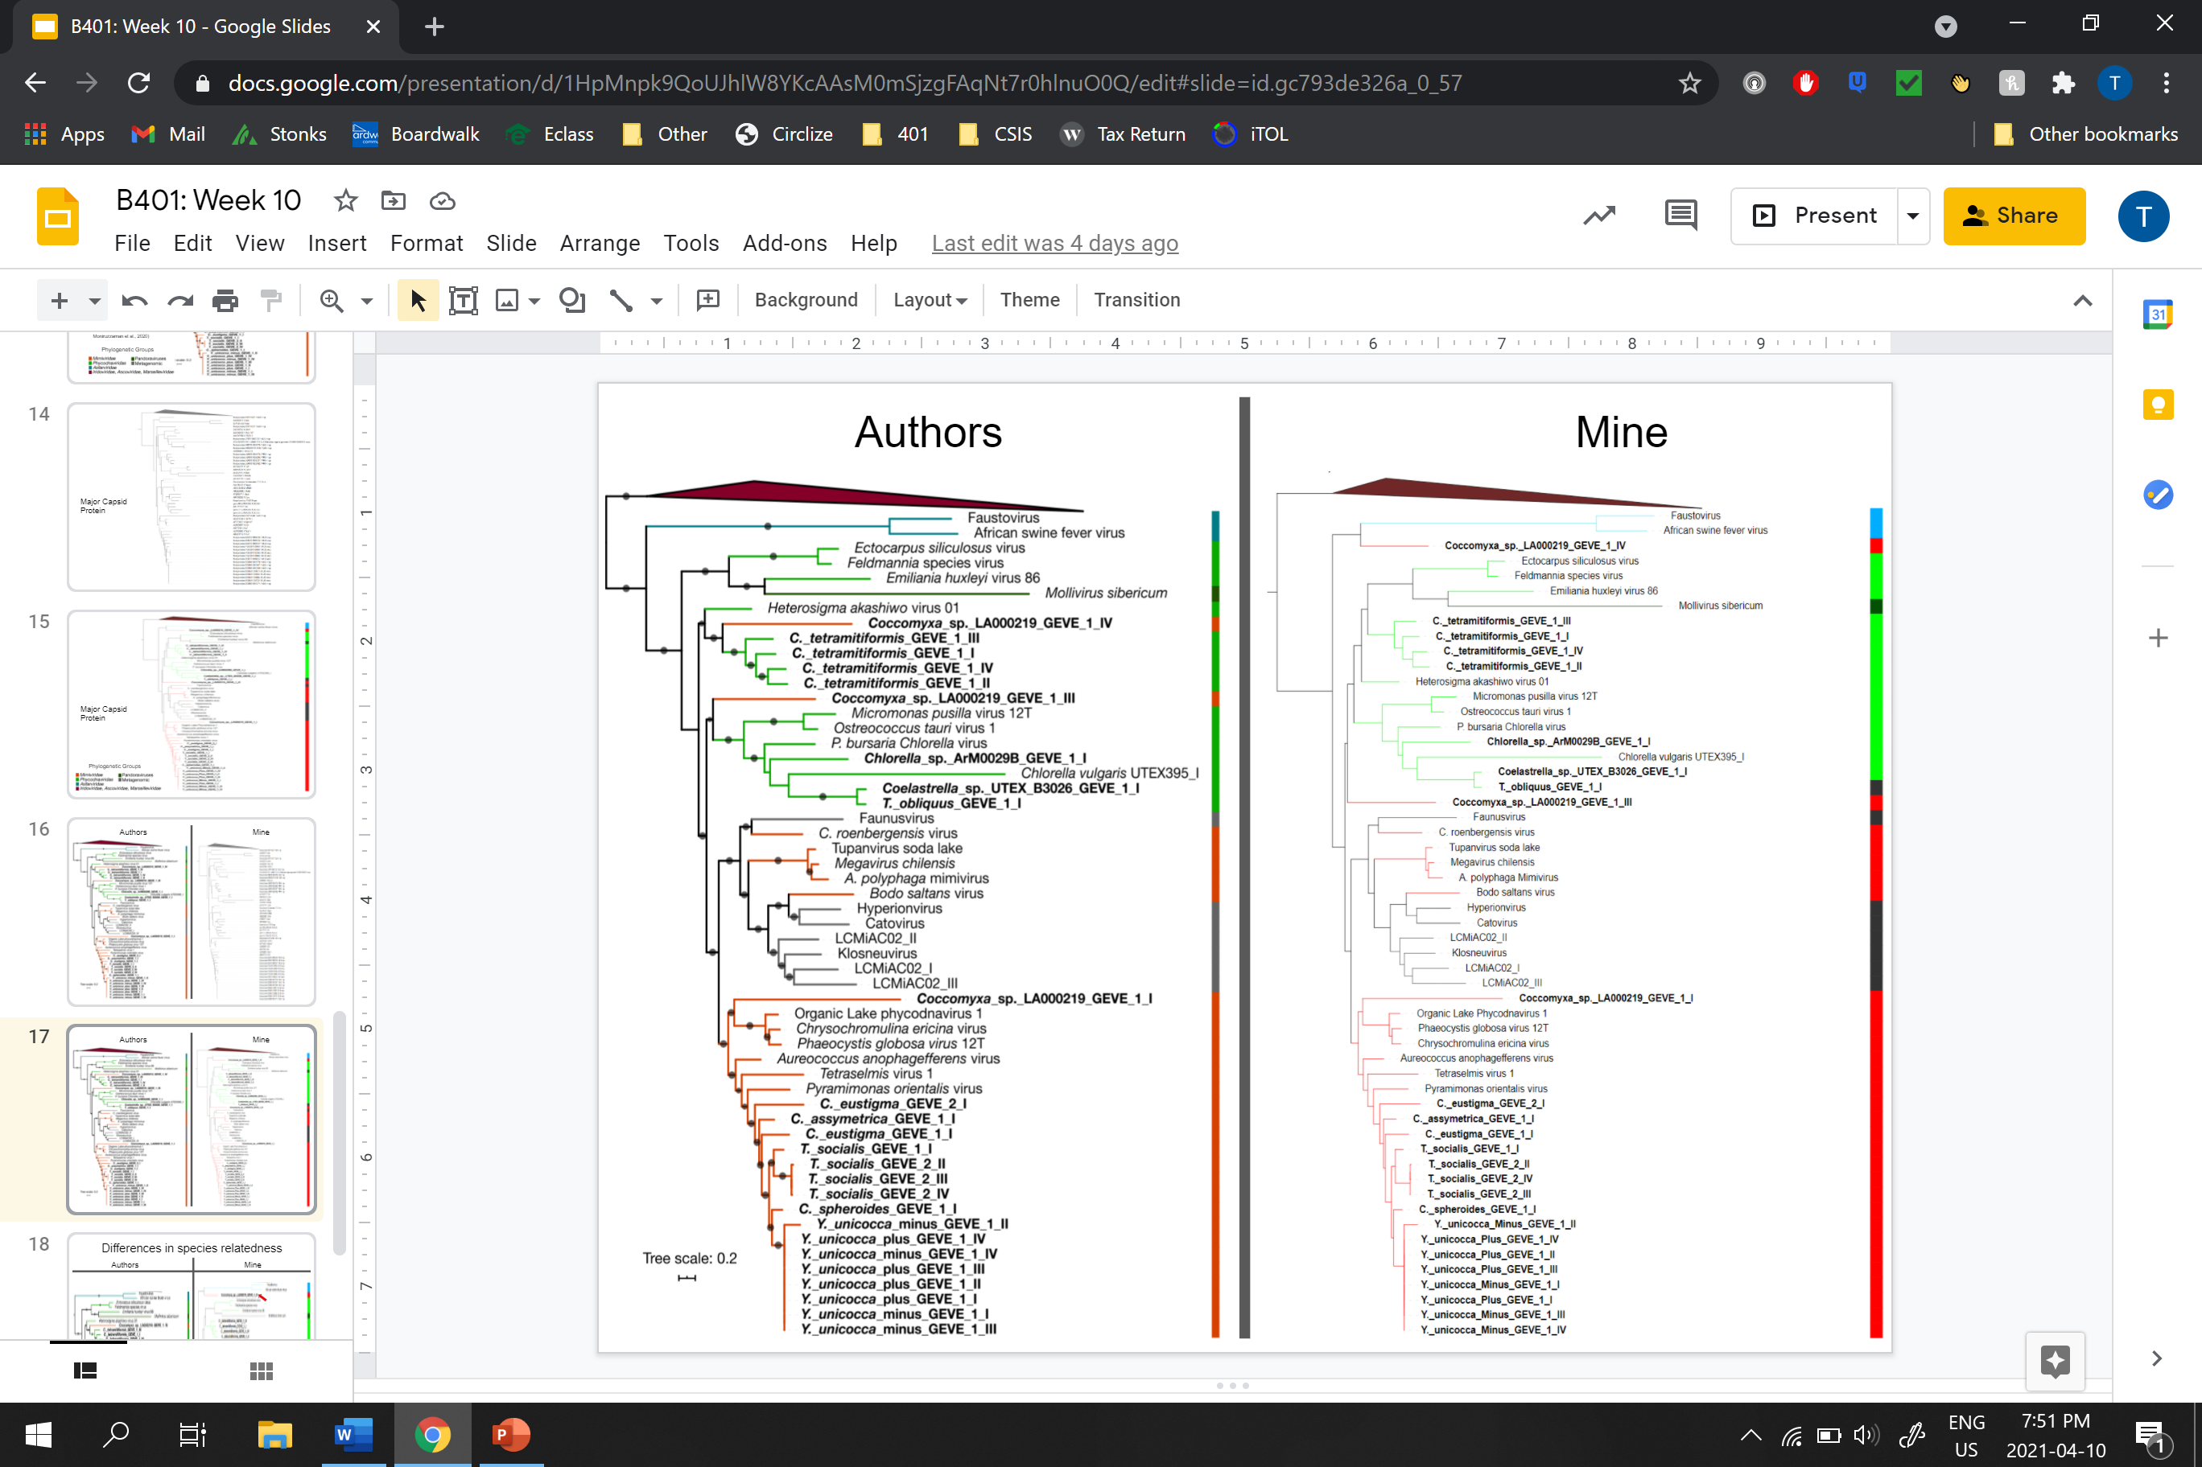
Major Capsid Protein

Slide 34
Major Capsid Protein

Slide 35
Week 11
10
11
8
9
March 30
Trying to add support values to the trees
Tested alternative tree visualization software

Slide 36
Week 12
12
9
10
11
April 6
Finished generating phylogenetic trees for figure 3
Added the Shimodaira–Hasegawa approximately likelihood ratio test values onto the phylogenetic trees

Slide 37
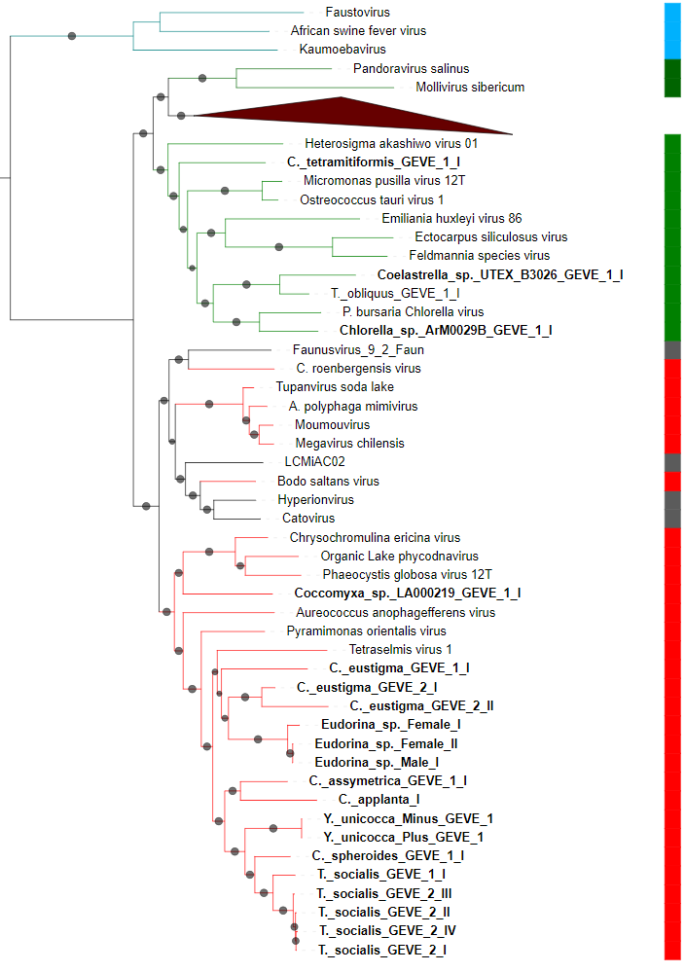

Phylogenetic Trees: DNA Polymerase
Phylogenetic Groups

Slide 38
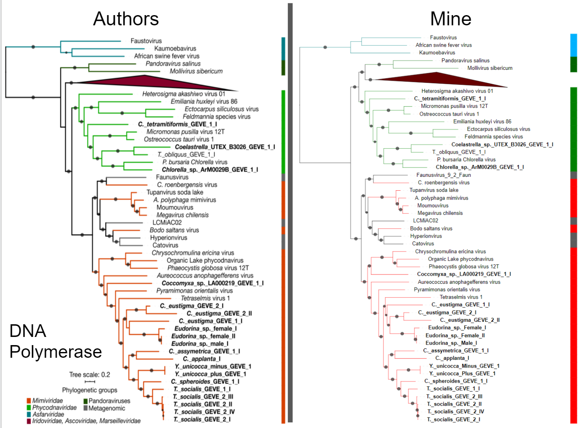

Slide 39
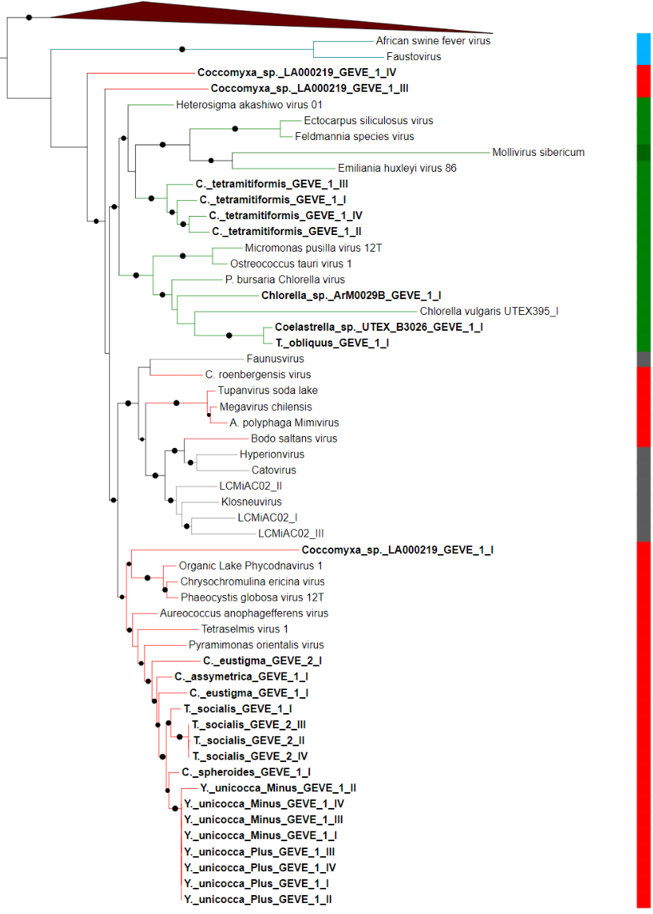
Phylogenetic Trees: Major Capsid Protein
Phylogenetic Groups

Slide 40
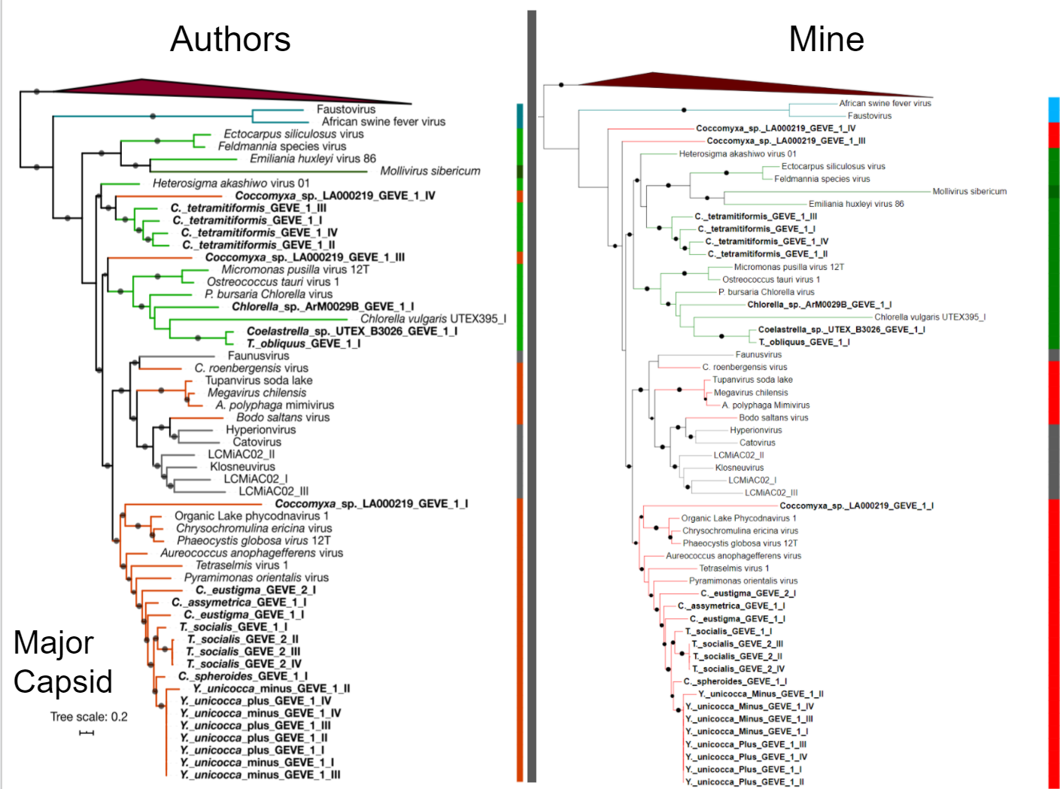

Slide 41
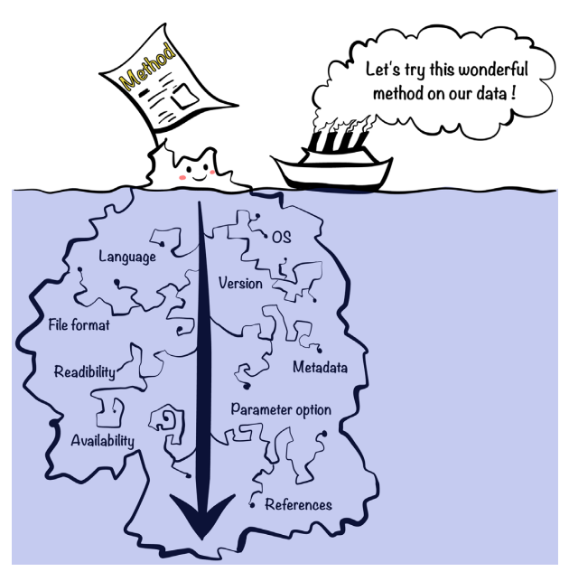
(Kim et al., 2018)

Slide 42
References
https://eol.org/pages/2915041
https://www.google.com/url?sa=i&url=https%3A%2F%2Fen.wikipedia.org%2Fwiki%2FGreen_algae&psig=AOvVaw0ozR3j2Gik6lXeMOCBoBss&ust=1617854907792000&source=images&cd=vfe&ved=0CAIQjRxqFwoTCIjpvauh6-8CFQAAAAAdAAAAABAD
https://www.researchgate.net/figure/a-The-brown-algae-Fucus-vesiculosus-is-the-dominating-brown-algae-on-rocky-substrate-in_fig7_303488214
Kim, Y., Poline, J., & Dumas, G. (2018). Experimenting with reproducibility: A case study of robustness in bioinformatics. GigaScience, 7(7), 1-8. doi:10.1093/gigascience/giy077
Moniruzzaman, M., Weinheimer, A. R., Martinez-Gutierrez, C. A., & Aylward, F. O. (2020). Widespread endogenization of giant viruses shapes genomes of green algae. Nature, 588(7836), 141-145. doi:10.1038/s41586-020-2924-2

